Slide 1

Homework 1 Wireshark INT4023
Dalton Murray

Slide 2
Website basics

Slide 3

Unsecured website (HTTP, no SSL certificate)
No encryption
Is more easily sniffable by anyone on network
Could be an indicator of a scam

Slide 4
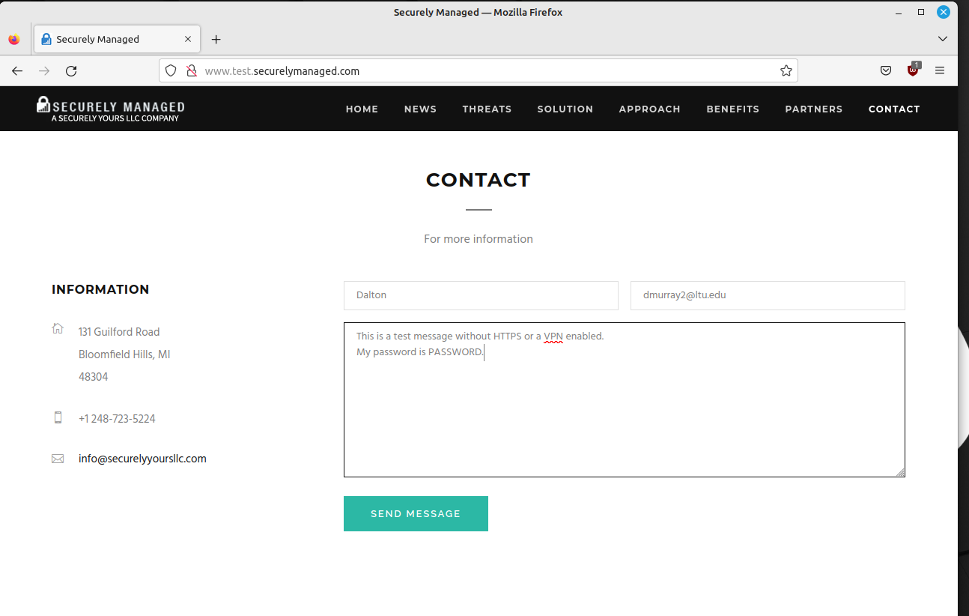
Form on an unsecured website
Be wary of information entered on an unsecure website, especially when submitting contact details or payment information

Slide 5
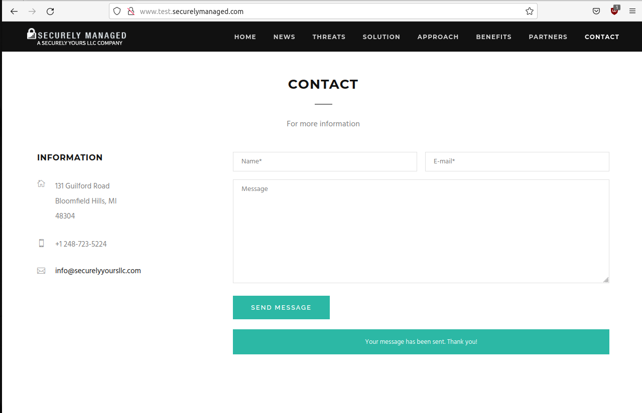
Submitted form

Slide 6
Wireshark basics

Slide 7
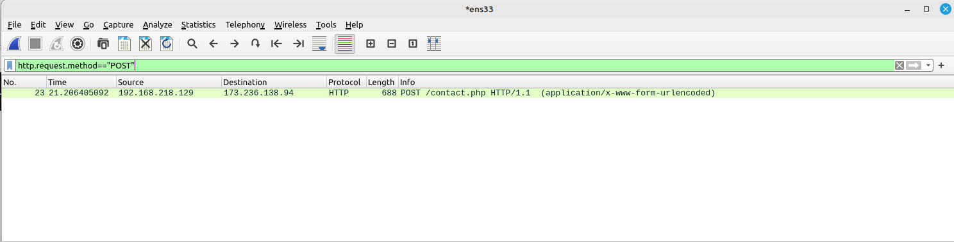
Wireshark – Filtered sniffing view
We can see with this since the website was unsecure, no encryption was used, and no VPN was on, so we can easily find a POST packet, which is what the form method for submission was

Slide 8
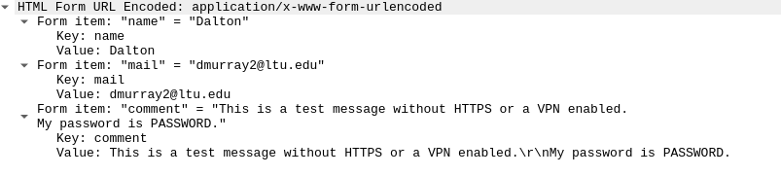
Wireshark – Form information found
Since we were able to find the form submission and it was not secure, we can get all submitted information from it in every box such as name, email, and anything additional submitted like passwords

Slide 9
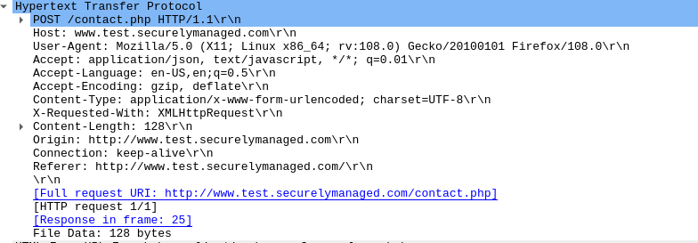
Wireshark – Browser information and website
We can even find more details about the person who submitted the form, such as what browser they were using
We can also see what website they submitted the form to, allowing an attacker to potentially use their information to login to the website

Slide 10
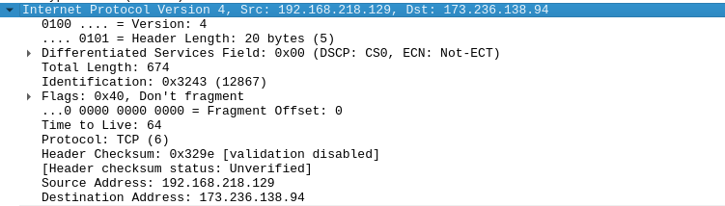
Wireshark – IP
We are also able to find the IP of the person who submitted the form (192.168.218.129) and the IP of the host/website/source (173.236.138.94)

Slide 11
Encrypted website

Slide 12
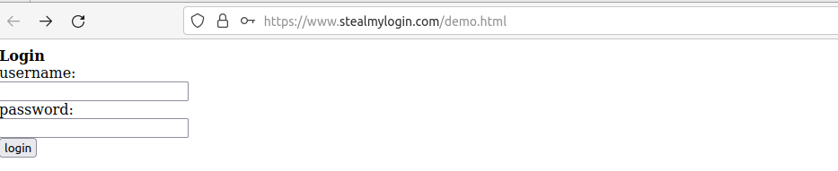
Unsecured website (HTTPS, SSL certificate)
Has encryption

Slide 13
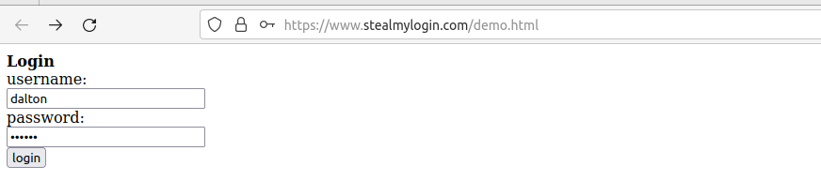
Secured website (HTTPS, SSL certificate)
Can more safely enter a username and password

Slide 14
Encrypted website - Wireshark

Slide 15
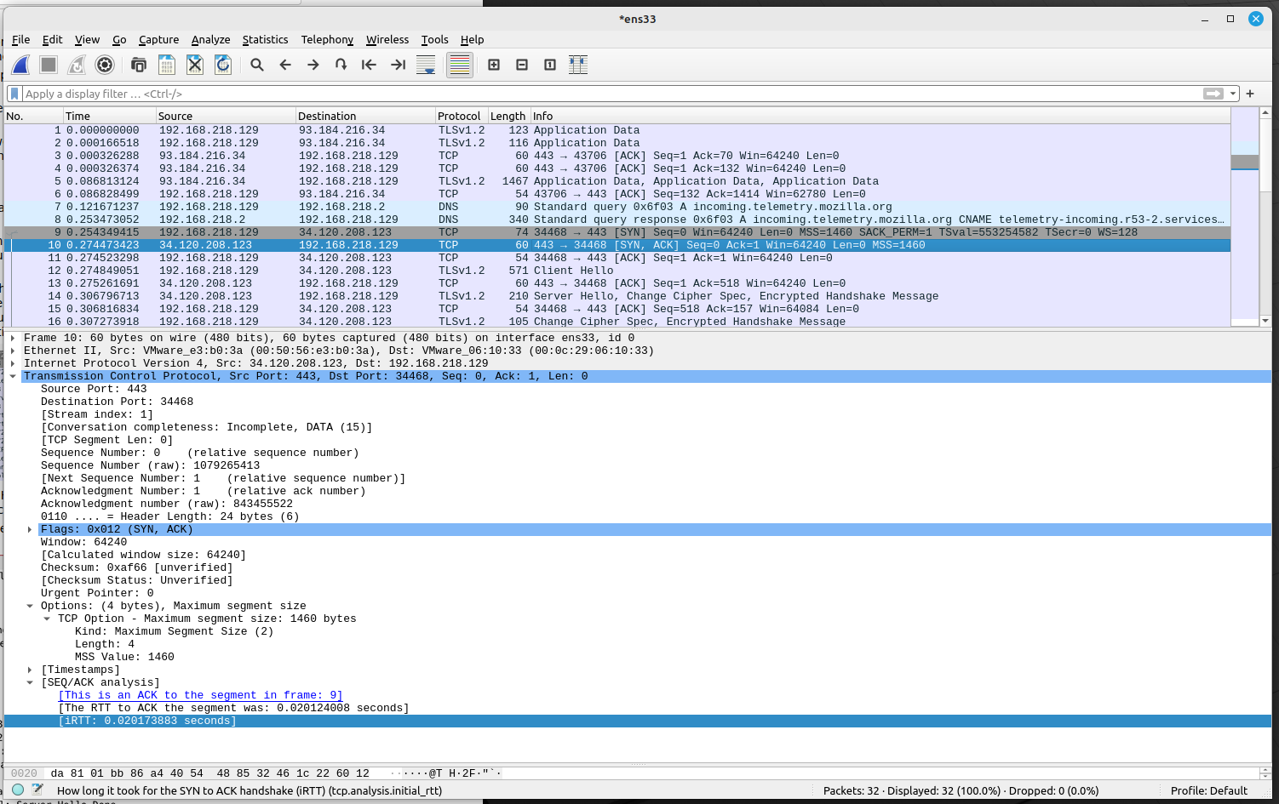
Client/Server acknowledgement
With a secured website the client and server perform a back-and-forth handshake/acknowledgement

Slide 16
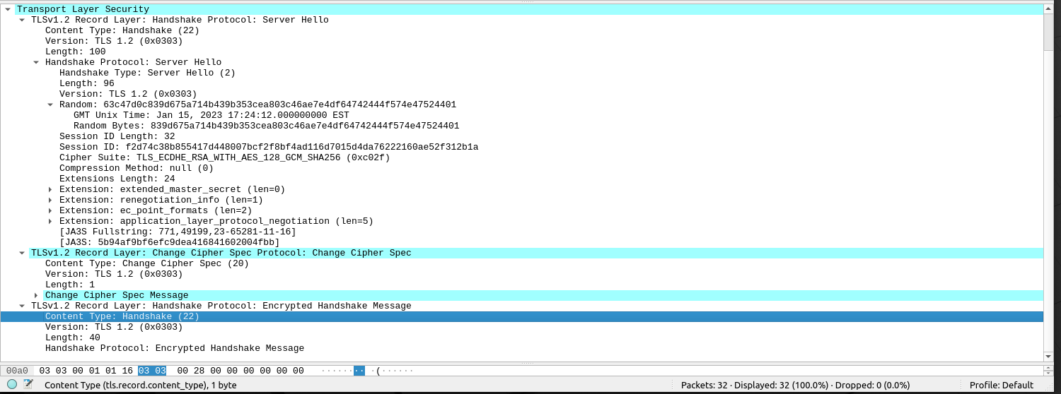
Client/Server agreed cipher
The client/server handshake is also where they agree on a randomly generated cipher/encryption key and other things such as TLS version, because of this the submitted form is encrypted, and I was unable to get any data from the Wireshark packets captured

Slide 17
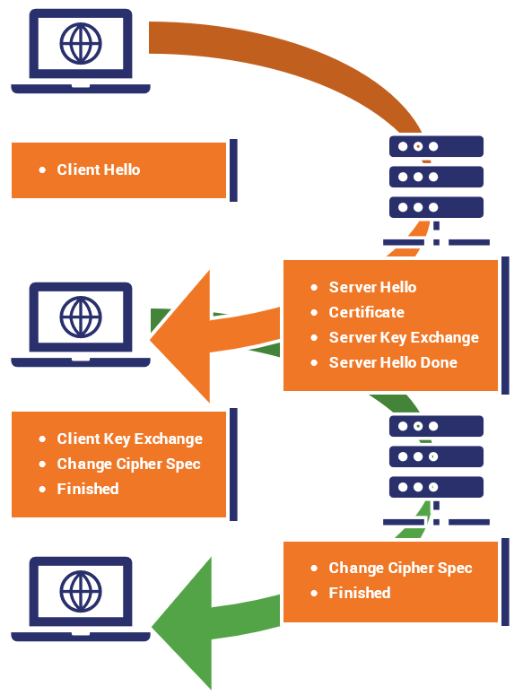
Client/Server handshake diagram
This diagram shows a basic example of a TLS/HTTPS handshake, where the client sends a message to the server, the server then sends back an acknowledgement with their certificate, sends their key exchange and finished the hello, the client receives this and sends back their key exchange, in this key exchange they negotiate on what type of cipher and generate a key, the client sends this back to the server and the server changes to match and sends back a completed message
https://www.thesslstore.com/blog/explaining-ssl-handshake/

